Slide 1
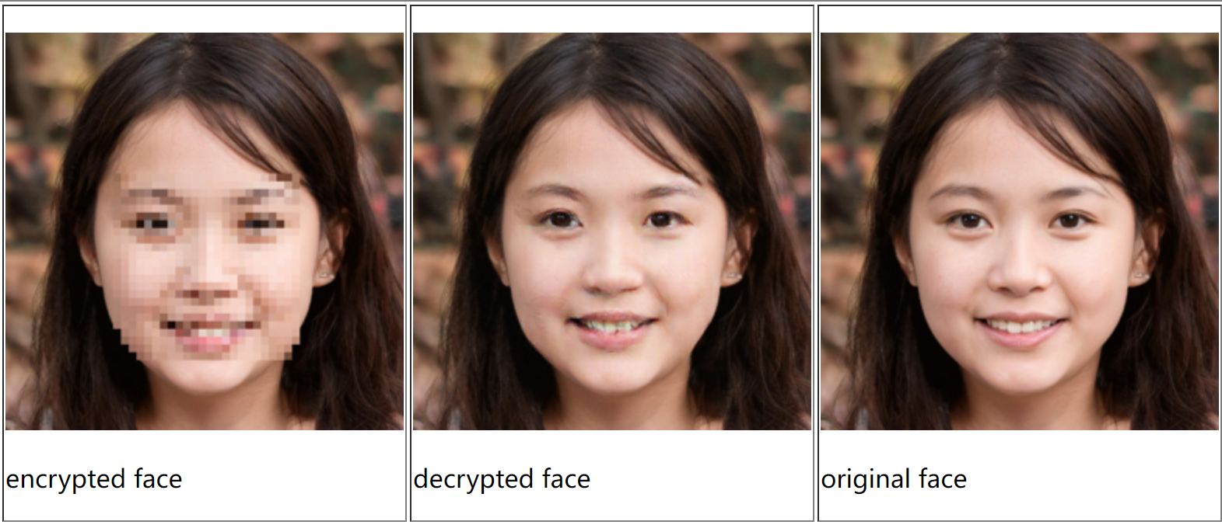
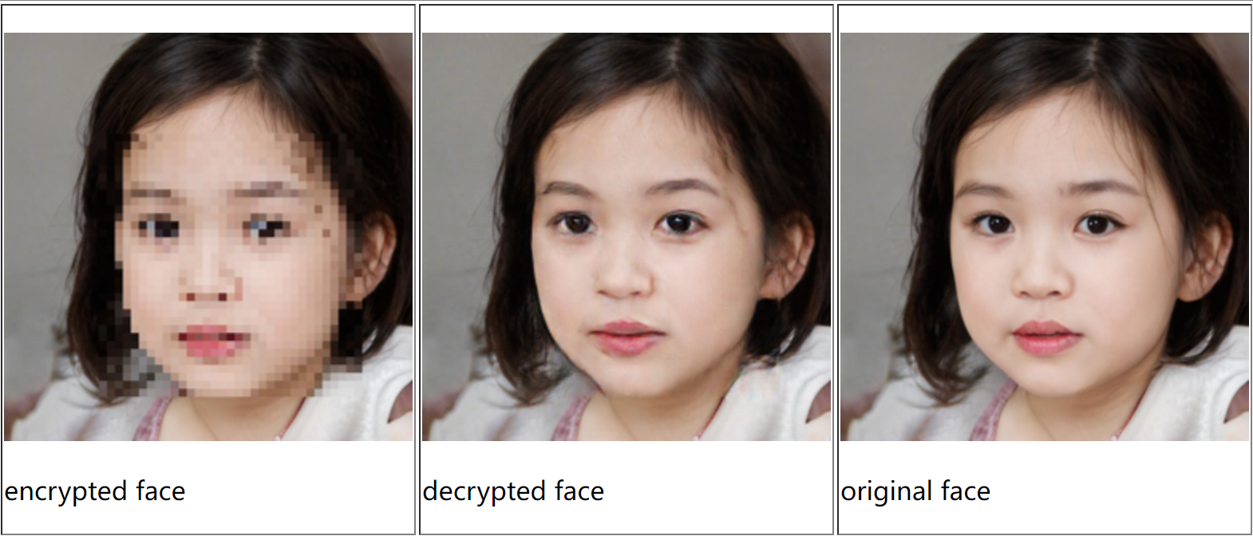
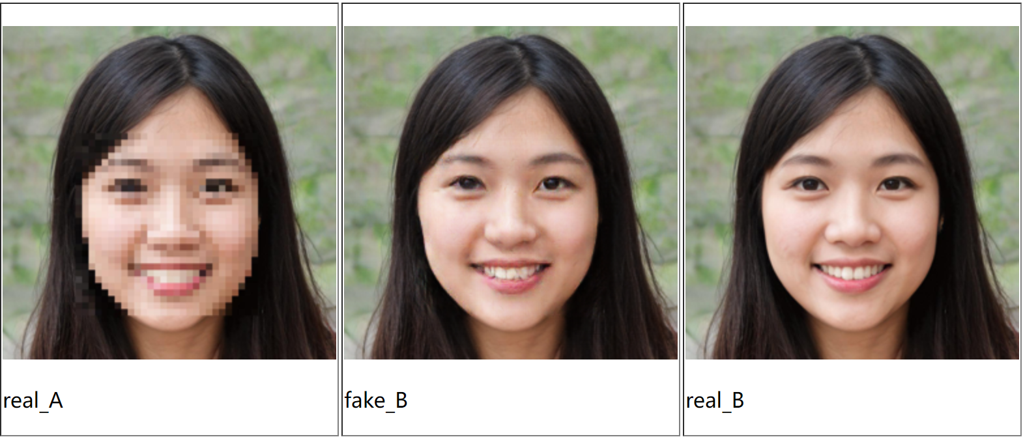
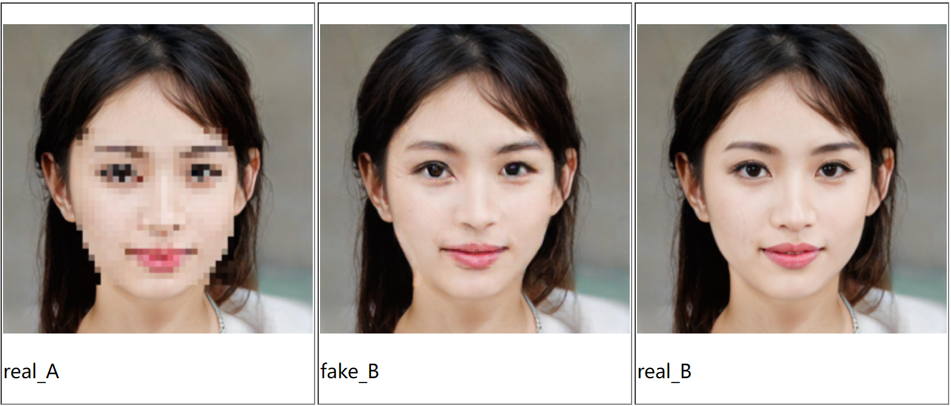
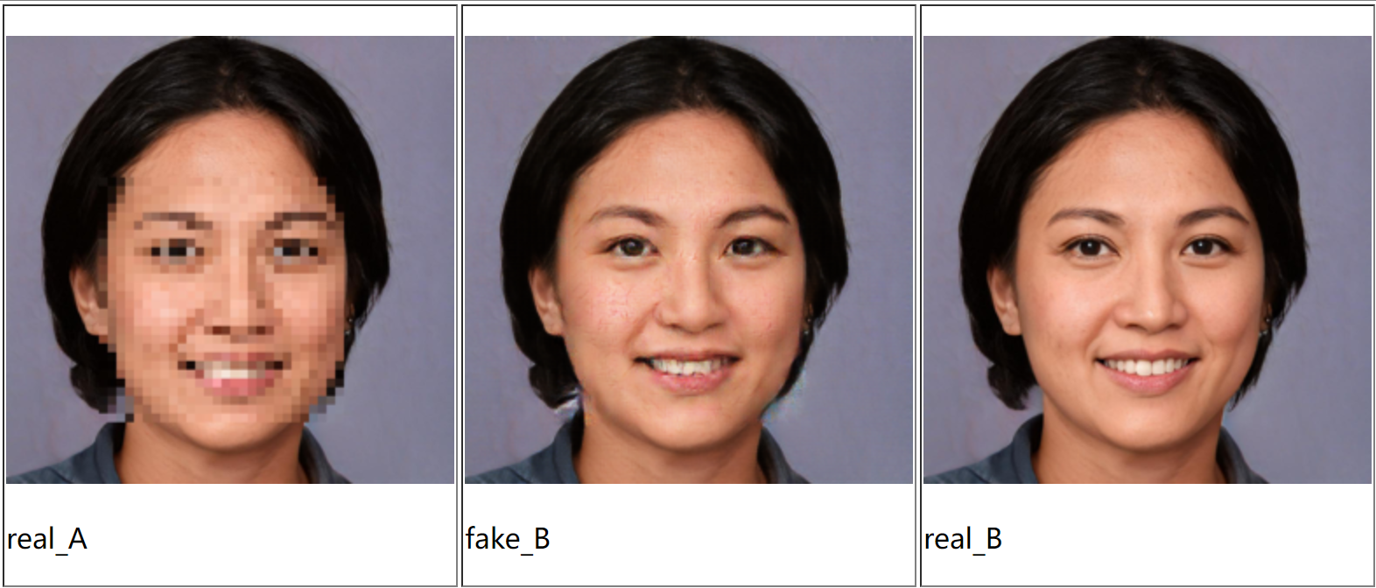
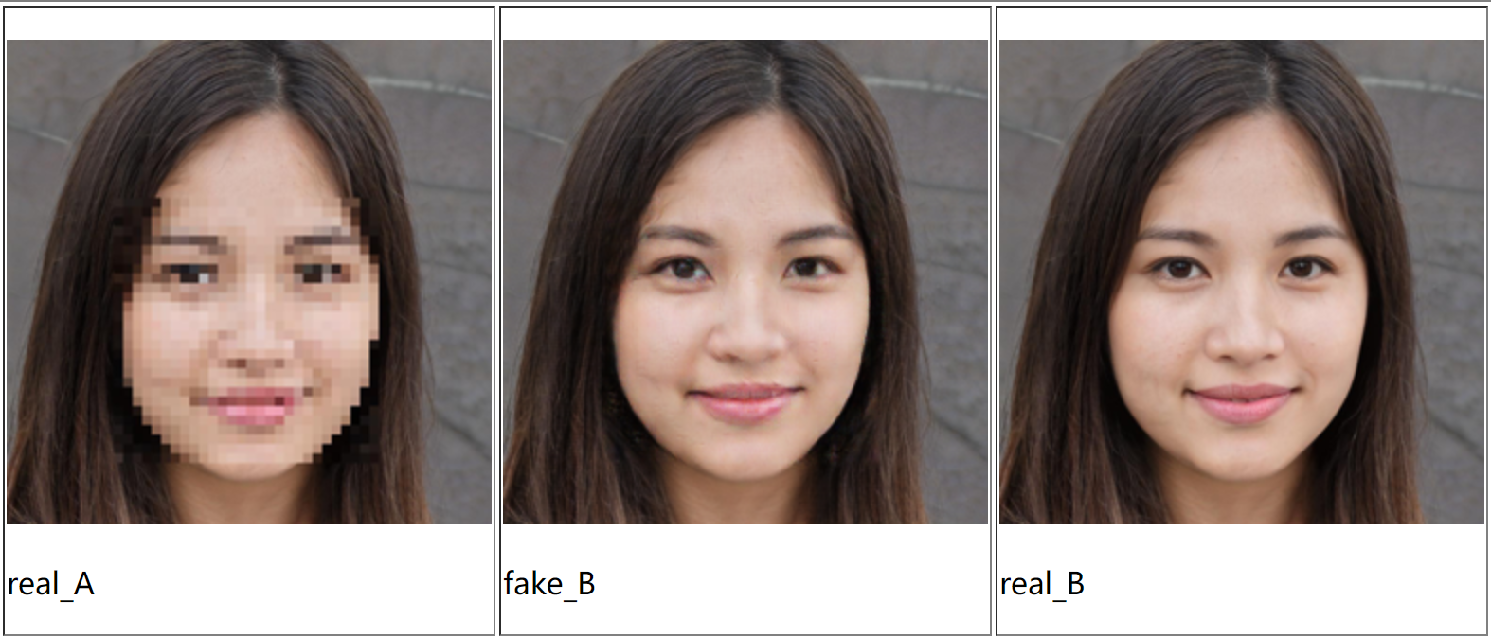
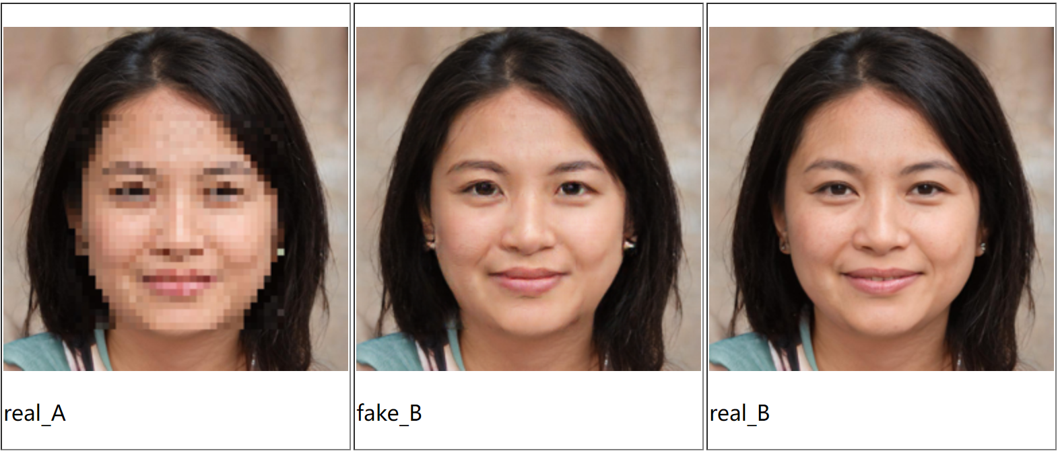
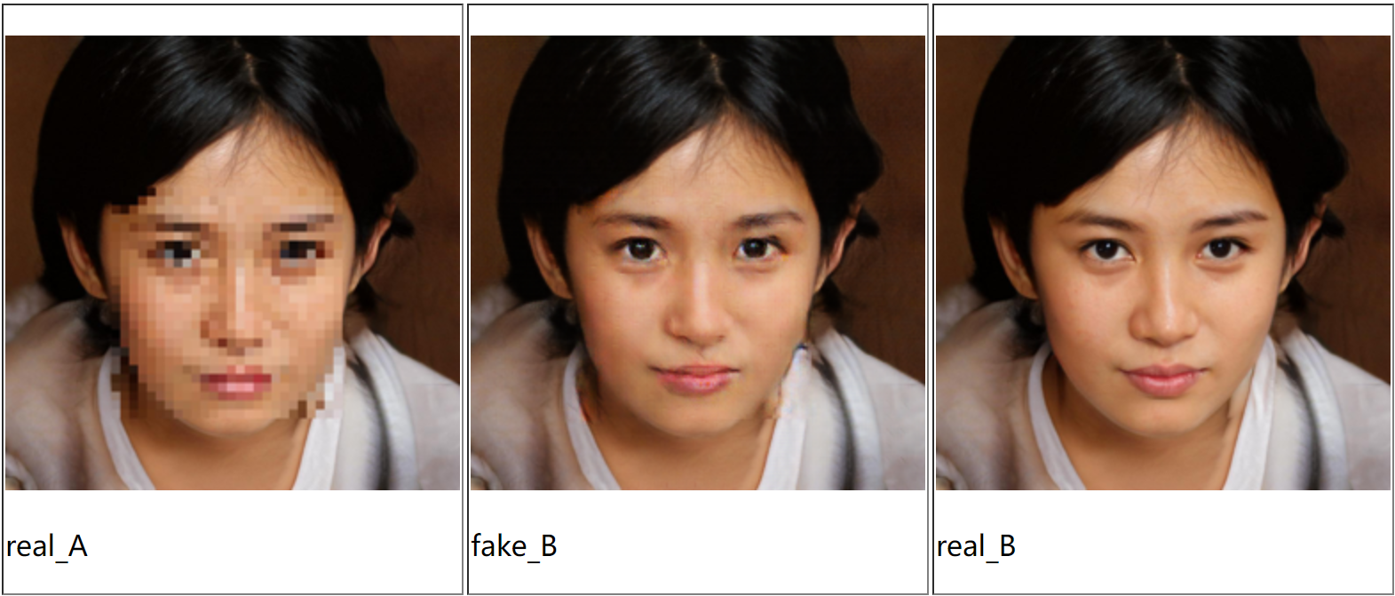
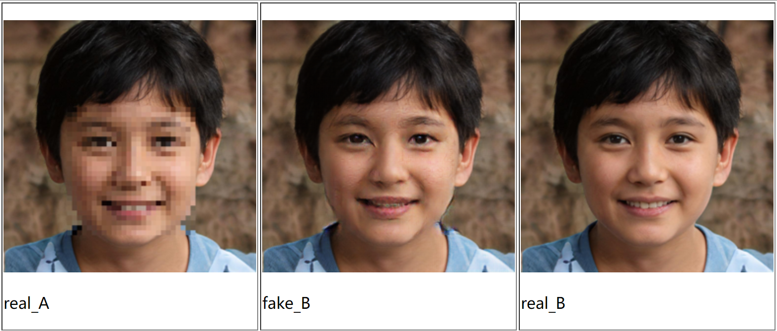

Slide 2
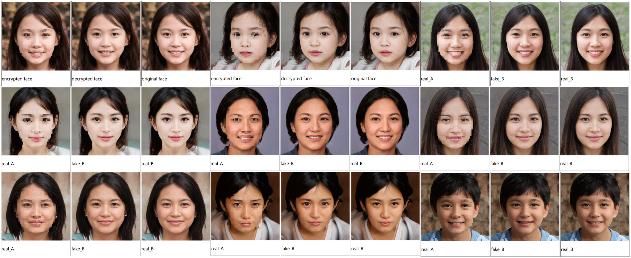

Slide 3
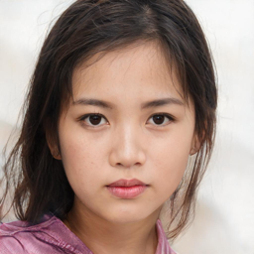
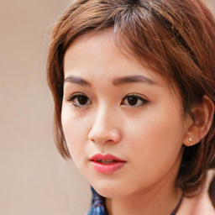
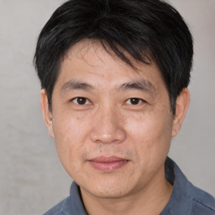

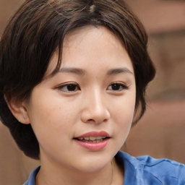
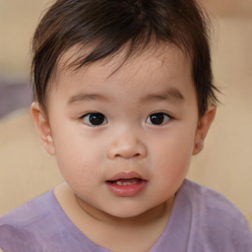
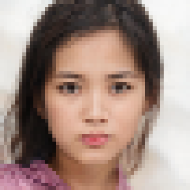
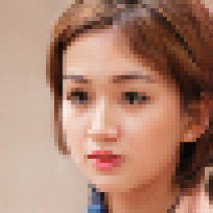
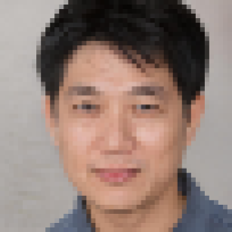
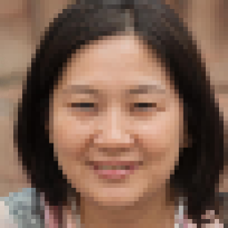

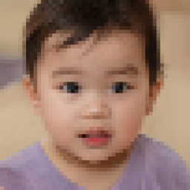
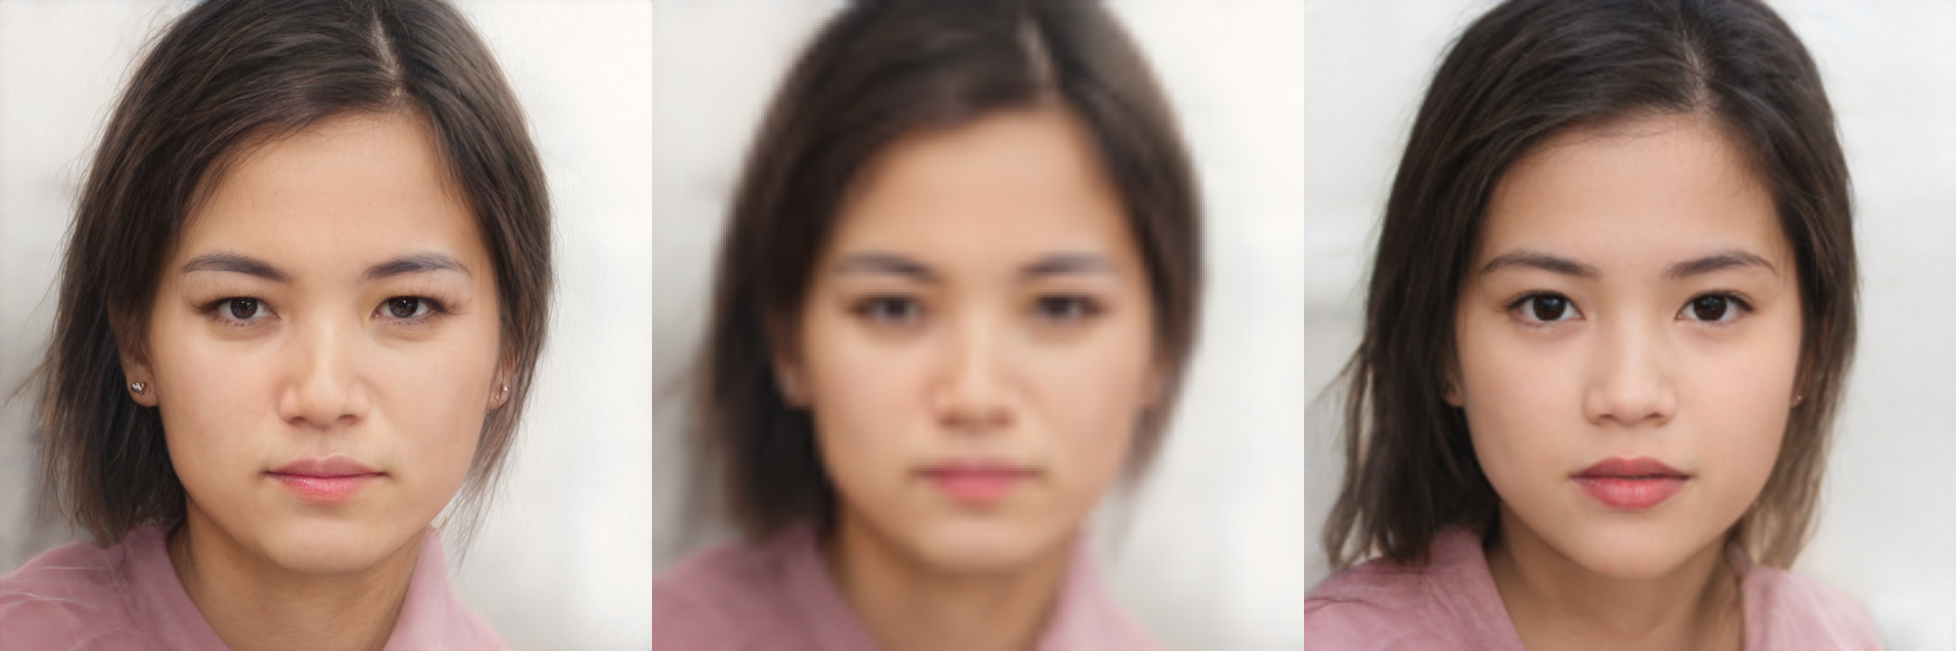
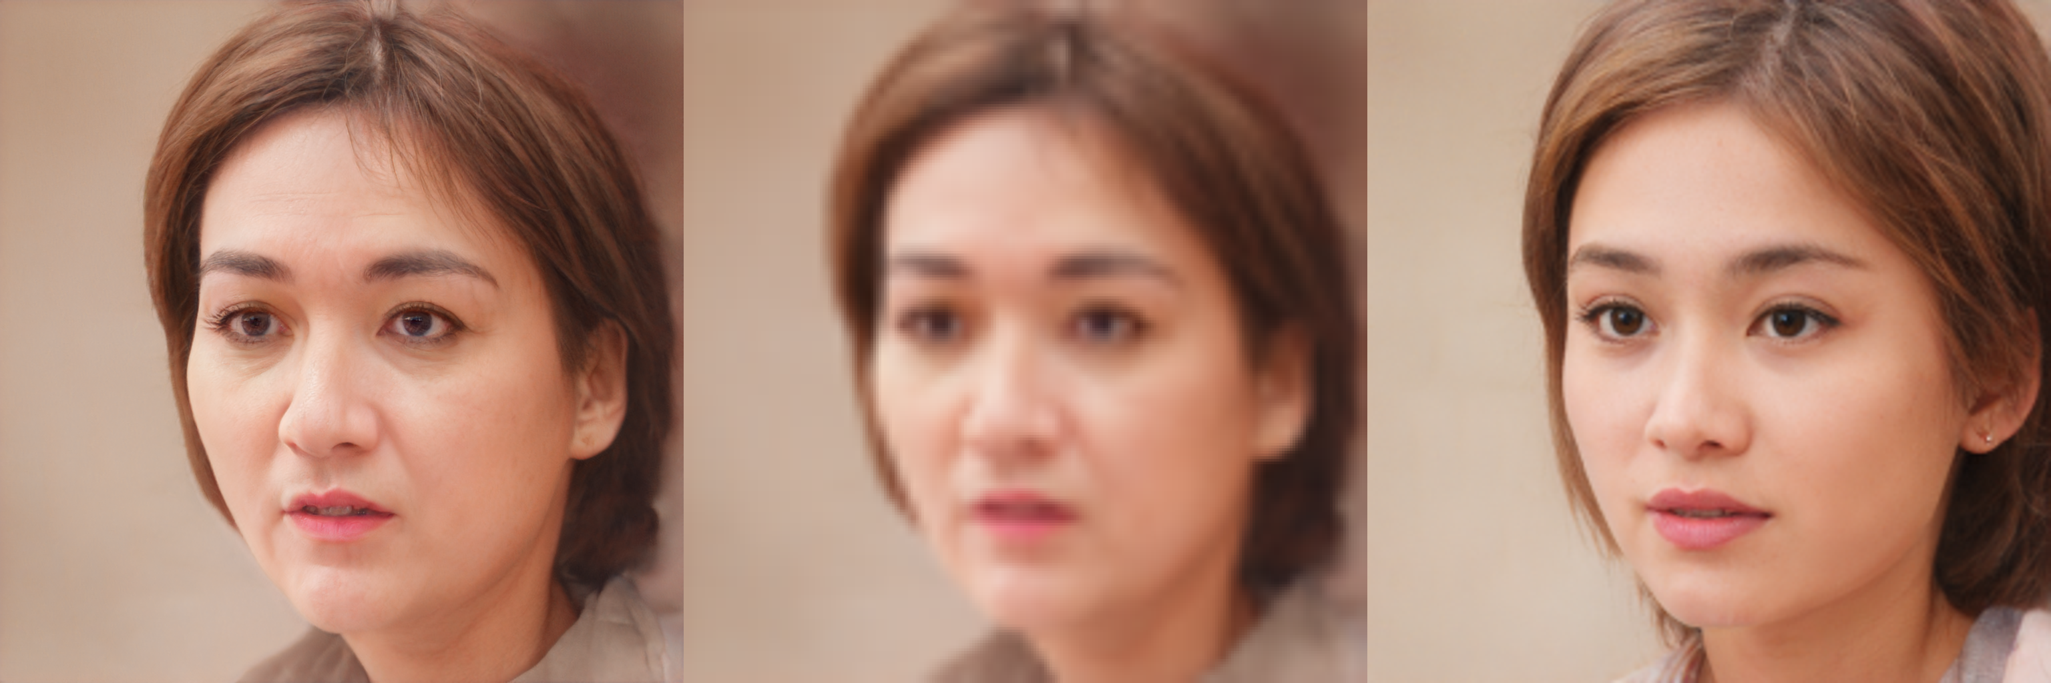
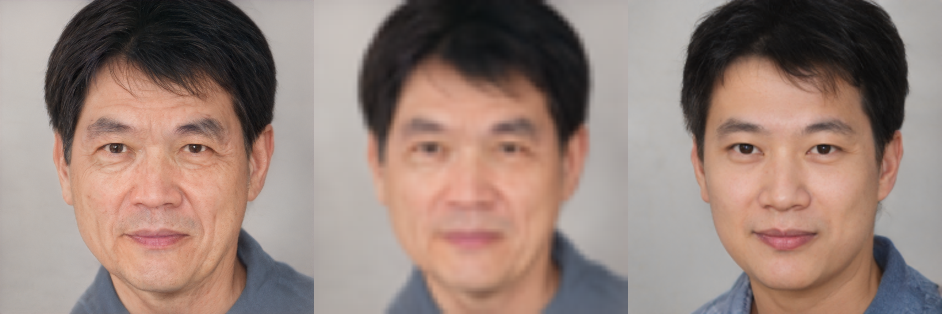

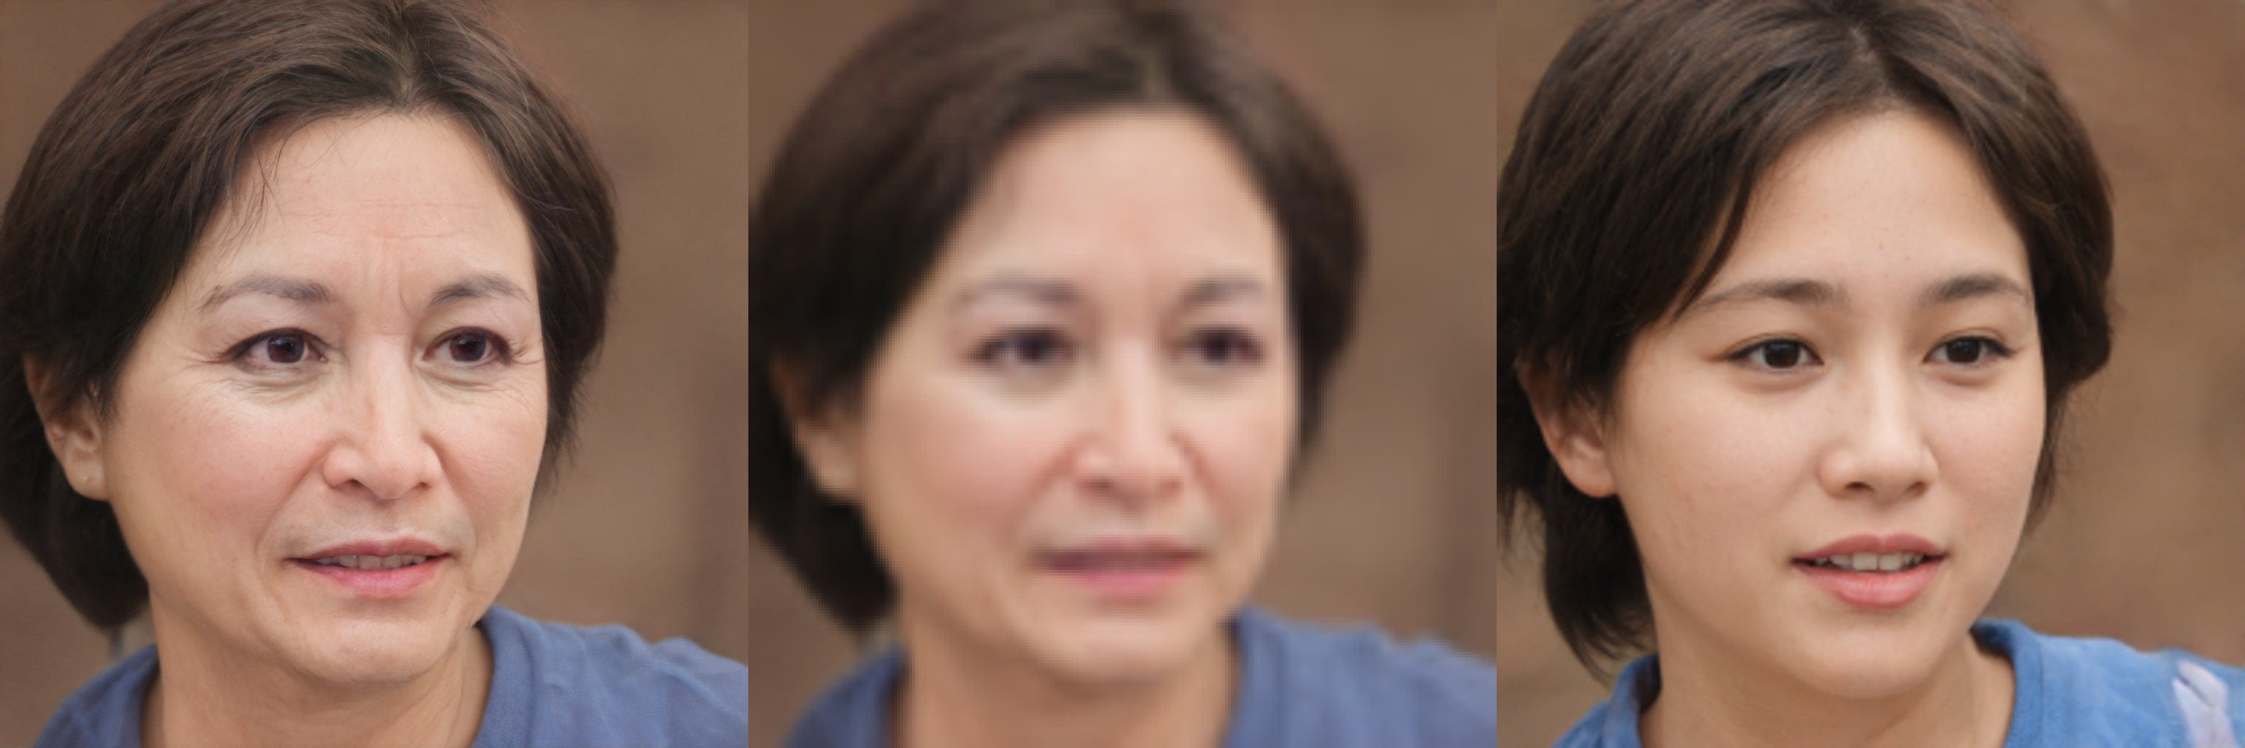
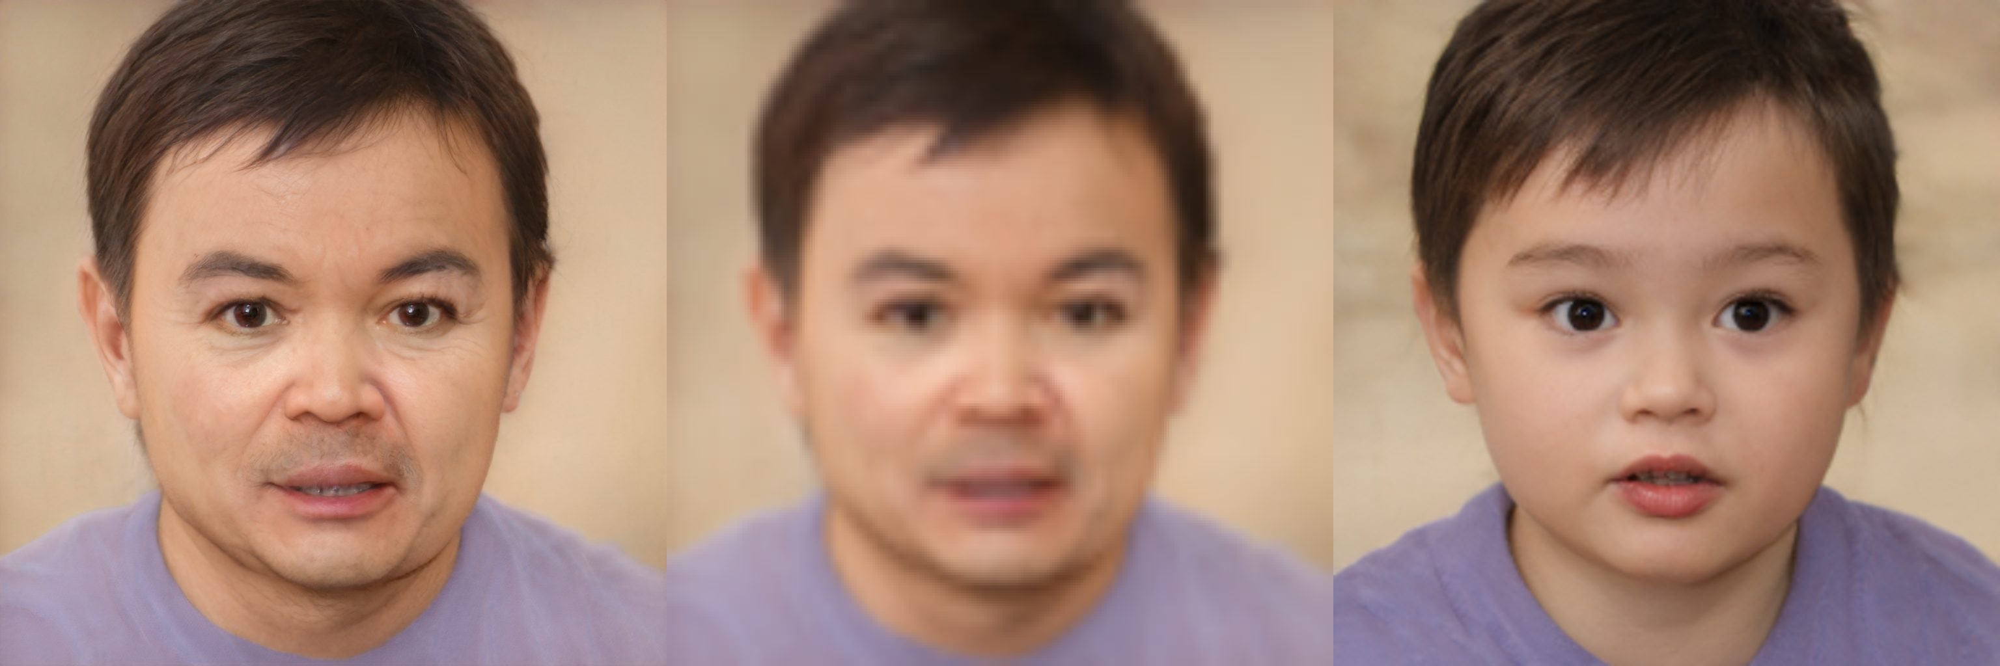
Original
Blurred
Aged
Recoverd

Slide 4

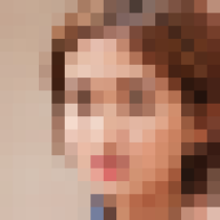
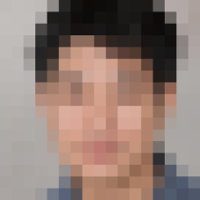
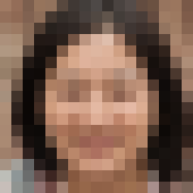
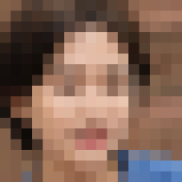
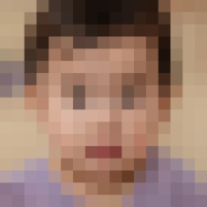
Original
Blurred
Aged
Recoverd

Slide 5
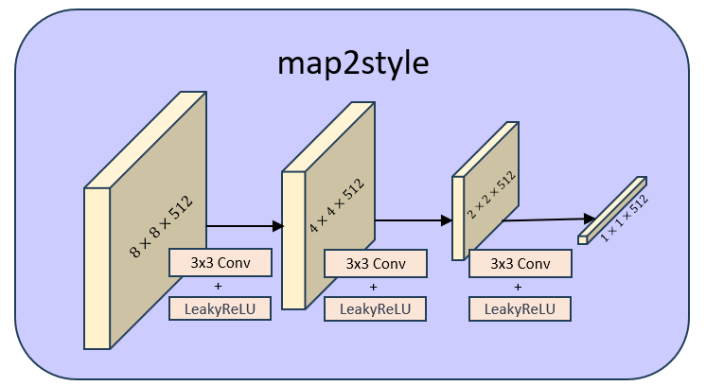
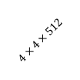
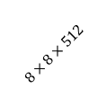
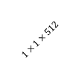
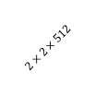
map2style
$$4×4×512$$
$$2×2×512$$
$$8×8×512$$
$$1×1×512$$
3x3 Conv
3x3 Conv
3x3 Conv
+
+
+
LeakyReLU
LeakyReLU
LeakyReLU
a)ResNet
b)Feature pyramid

Slide 6
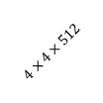
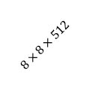
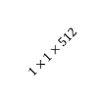
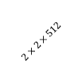
map2style
$$4×4×512$$
$$2×2×512$$
$$8×8×512$$
$$1×1×512$$
3x3 Conv
3x3 Conv
3x3 Conv
+
+
+
LeakyReLU
LeakyReLU
LeakyReLU

Slide 7
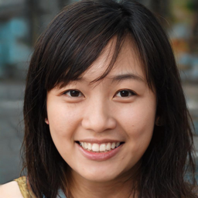
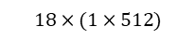




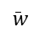
pSp Encoder
average
latent code
Input Image
$$w_{1}$$
map2style
$$w_{2}$$
map2style
0-2
+
$$w_{3}$$
$$\overline{w}$$
map2style
.
.
.
.
.
.
map2style
3-6
$$w_{18}$$
map2style
.
.
.
$$18×(1×512)$$
map2style
7-18
a) ResNet
b) Feature pyramid
c) Map2style
d) Add latent_avg

Slide 8

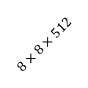
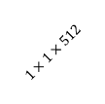
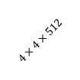
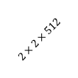
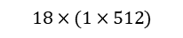
pSp Encoder
latent code
average
map2style
$$w_{1}$$
…
$$w_{2}$$
+
map2style
$$w_{3}$$
$$\overline{w}$$
0-2
…
$$w_{18}$$
map2style
$$18×(1×512)$$
…
d) Add latent_avg
map2style
map2style
3-6
map2style
$$2×2×512$$
…
$$8×8×512$$
$$4×4×512$$
$$1×1×512$$
Input Image
map2style
3x3 Conv
+
3x3 Conv
3x3 Conv
7-18
+
+
+
a) ResNet
b) Feature pyramid
c) Map2style
LeakyReLU
LeakyReLU
LeakyReLU

Slide 9
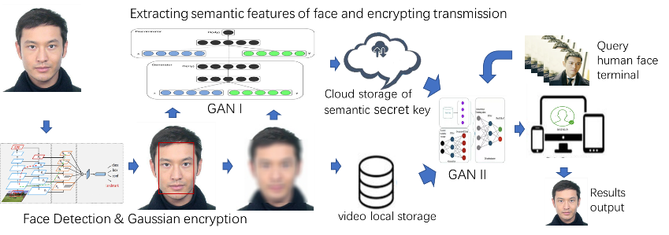

Slide 10
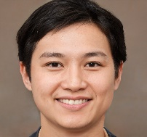
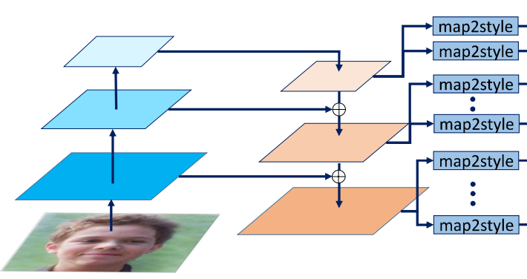








Extracting semantic features of face and encrypting transmission
Query human
face terminal
Cloud storage of semantic
secret key
Encoder
GAN generator
Face Detection & Gaussian encryption
video local storage
Results output

